Slide 1
Probate diversity survey 2021: what you need to know webinar
3 February 2021

Slide 2
Your presenters
Peter James, Head of Regulatory Policy
Professional Standards, ICAEW
Lindsey Samways, Customer Success Manager for Digital Learning & Compliance, The Access Group

Slide 3
Today’s webinar
The political backdrop
Probate diversity survey – the benefits to your firm
2021 diversity survey – what does your firm need to do?
2021 survey – which questions have changed and why?
Collecting data – the options
Publishing requirements
What to send to ICAEW
2021 reporting
Key dates for your diary
Further ICAEW support
Q&A

Slide 4
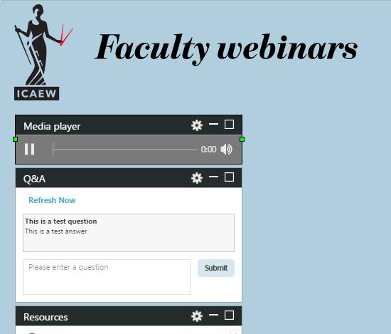
Ask a question
Ask a question
Type your question into the question box
then click submit.

Slide 5
Political Backdrop
Covid has brought a significant change in work patterns and with it greater opportunities for accountancy practices.
The damage to childhood education in 2020 has highlighted the needs of children from poor backgrounds and social mobility needs in society
The Black Lives Matter movement has caused government and institutions to more resolutely address weak practices.
ICAEW strategy and vision for 2020-2030 includes the strategic theme of strengthening the profession by attracting talent and building diversity

Slide 6
The benefits to your firm
All firms accredited for probate services are required to collect, report and publish diversity data about their employees.
There are many benefits to focusing on diversity and inclusion: Stronger culture, better performance, deeper customer insight.
A competitive advantage.
‘The client base is changing. With the demographics of the UK rapidly changing, diversity is essential for firms wanting to attract the best people and meet clients’ needs.’ The Law Society’s Benefits Diversity and inclusion in law firms: the business case

Slide 7
What does your firm need to do
All staff (permanent and temporary) should ideally complete the ICAEW probate diversity questionnaire.
Not just those working with probate clients.
Optional.
Create a Riliance survey link and email it to your staff.
The survey questions and aggregated response template are also available in the resources section of this webinar and at icaew.com/probatediversity
Please share the survey link with employees who are not currently in the workplace eg, maternity leave / long-term sick leave (assuming they are in contact with the office and wish to be contacted).
Publish the aggregated results on your website by 31 May 2021.
Send the aggregated results (we must not receive staff’s individual responses) to ICAEW by 30 April 2021.

Slide 8
2021: Which questions have changed and why?
Question | Characteristic | Status | Comments
1 | Role | Unchanged
2 | Age | Unchanged
3 | Gender | Changing | Modifying to align with Cilex
4 | Disability | Changing | Adding drill down question
5 | Ethnic Group | Unchanged
6 | Faith | Unchanged
7 | Sexual Orientation | Unchanged
8 | Socio-Economic background | Changing | SMC guided approach
9 | Social Mobility | Changing | SMC guided approach
10 | Caring responsibilities | Unchanged
11 | Marital status | New | At request of LSB
12 | Maternity | New | At request of LSB.

Slide 9
2021: Which questions have changed and why?
Social Mobility – questions have been updated to reflect latest guidance from government
Matrimonial status – LSB request – informs firm benefits programmes
Maternity/paternity leave – informs working patterns and retention
Gender recognition – understanding needs of trans staff
Disability – drill down to understand type – informs working pattern

Slide 10
Collecting data – the options
We have partnered with Riliance for the 2021 survey to give our firms access to their survey tool for free.
Sole practitioners with no staff may wish to email regulatorysupport@icaew.com directly with their results. The ‘prefer not to say’ option is available for all questions if there are any answers you would prefer not to share.
Riliance demonstration.

Slide 11
Publishing requirements
Publish the aggregated results on your website by 31 May 2021.
Include a summary paragraph about the results.
No website? You must publish the data on documentation eg, as a paragraph in a letter of engagement or in advertising materials.
Could anonymity be compromised? If the data is collected from relatively small data-sets, individual staff members may be identifiable. Adapt the information you publish if required.

Slide 12
What to send to ICAEW
Send the aggregated results (we must not receive staff’s individual responses) to ICAEW by 30 April 2021.
Please submit the results to regulatorysupport@icaew.com
Please include your firm number (C00xxxxx) with your submission.
Please ensure you download the Riliance report and send the results to ICAEW before the deadline. Riliance will not submit your data for you.
ICAEW will keep aggregated results for three years.
Please note late submissions may result in a regulatory penalty

Slide 13
2021 reporting
As with the previous surveys, we’ll publish an infographic one page summary report as well as a full report. You can use these to benchmark your firm against other firms to:
Understand the profile of your current teams and plan for future recruitment.
Identity opportunities: Has your firm got the right people in place to reflect current and future client profiles?
The reports will be available on icaew.com/probatediversity and via Probate News.

Slide 14
Key dates for your diary
31 March 2021 – Staff to complete the survey as close to this date as possible
30 April 2021 – Deadline to send your aggregated, anonymised results to RegulatorySupport@icaew.com
31 May 2021 – Deadline to publish your firm’s aggregated, anonymised results on your website
Summer 2021 – ICAEW will publish their 2021 diversity data report

Slide 15
Further ICAEW support
More information about collecting data, previous survey results and the diversity questionnaire template are available at icaew.com/probatediversity.
Our Technical Advisory Services team is available to help. Please call them on +44 (0)1908 248 250 or by email contactus@icaew.com

Slide 16
Q & A

