Slide 1
Money Laundering Risk Assessments
Live AML webinar: 15 FEBRUARY 2022
Due to a high number of attendees, it may take a few minutes for everyone to filter into the webinar. Please wait for the webinar to start.

Slide 2
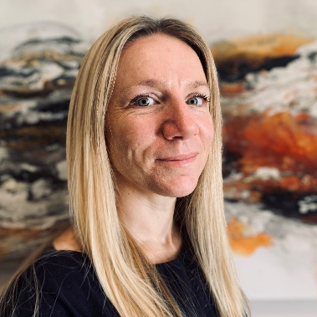
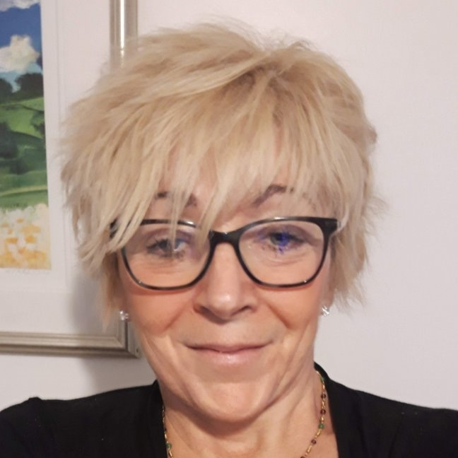
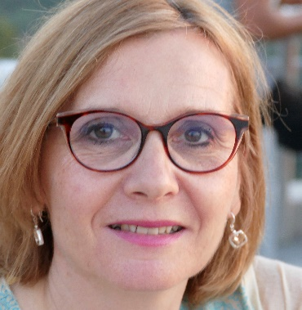
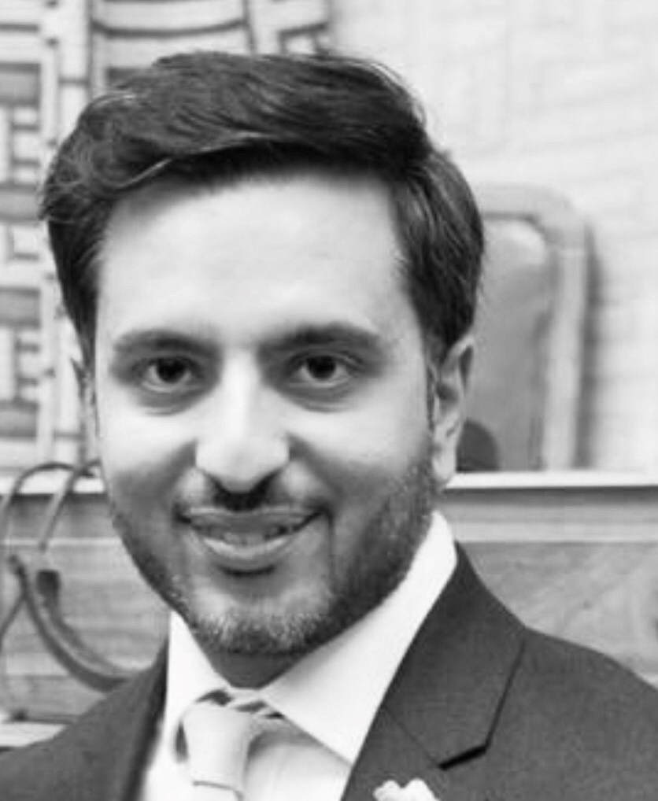
Today’s presenters
Michelle Giddings, Head of AML,
Professional Standards
ICAEW
Sandy Price
AML Manager
Professional Standards
ICAEW
Angela Foyle,
Financial Services Partner,
BDO
Nikhil Manek,
MLRO and Director,
KPMG
Notes:
Good afternoon and welcome to this webinar on suspicious activity reports and the accountancy sector.
I’m Michelle Giddings. I’m the Head of AML within Professional Standards at ICAEW and I have lead regulatory responsibility for AML supervision of ICAEW member firms.
I’m joined by Angela Foyle, partner at BDO. Angela is chair of the Economic Crime Sub-Committee at ICAEW and Chair of the AML Committee of Accountancy Europe. She also held the MLRO role at BDO.
Nikhil Manek is MLRO and overall lead for financial crime at KPMG and Sabah Hussain, Senior Associate in the Financial Crime Team at PwC.

Slide 3
Agenda
Introduction
What should you consider as part of your risk assessment?
What will the supervisor expect to see?
Example of a risk assessment
Case studies
Q&A

Slide 4
What should I consider as part of my risk assessment - CCAB guidance
Client
PEPs, complex business structures, business rationale, secrecy, business activites
Transactions
Will you handle client money for the client?
If so, why? Is there a risk of handling proceeds of crime?
Delivery
Have you met/will you meet the client?
Services
Geographical
Payroll/probate/company formation
Check if high risk third country.
Are they local to your firm? If not, why did they choose you?

Slide 5
What will the supervisor expect to see?
A documented risk assessment;
a conclusion on risk; and
verification proportionate to risk.

Slide 6
Example of a risk assessment
Client
Carpenter; self-employed; not a PEP; sources of wealth are the business income only; and no evidence of living beyond his means.
Geographical
Locally based, local address and clients are local. No obvious risk.
Transactions
He does not want us to handle client money.
Services
I have met Bob at his premises; he was referred to me by another client. No obvious risks
We are preparing his accounts and self-assessment tax return (not a higher risk for us).
Delivery
Possibility of incomplete records but he does keep good records and we have all banks statements / records of transactions.
Cash takings - We have advised him of the risks of under declaration of earnings, we will monitor profit margins. He has agreed to use XERO and we will set him up on this.

Slide 7
Conclusion
Conclusion on risk of money laundering
  Low / normal / high
Verification
  Passport provided when I visited the home address (verified).
Signed
  Dated and signed by partner as approved for take on.

Slide 8
Further Guidance
CCAB Guidance
  ccab.org.uk/anti-money-laundering-guidance-for-the-accountancy-sector
AMLbites
  icaew.com/amlbites
AML risk and the risk-based approach
  icaew.com/moneylaundering
  Includes AASG risk outlook
  Risk bulletins
National Risk Assessment 2020
  gov.uk/government/publications/national-risk-assessment-of-money-laundering-and-terrorist-financing

Slide 9
Case study 1: facts
Victoria is a violin teacher. In addition to her part-time teaching at a local school (for which she is paid through the school payroll), she also teaches private lessons. Some of these lessons are paid in cash.​
Victoria is married to Albert. Albert runs a music shop. In addition to sales of instruments, CDs, Vinyl, music books and sheet music, Albert also hires out musical instruments. Usually about one third of Albert’s turnover is in cash. Business had been declining in recent years because of the move to online streaming of music. However, during lockdown, Albert started selling online. He funded this transition using a Government “bounce-back loan”. Despite the move online, cash sales remain high.​
Victoria and Albert would like you to prepare their business accounts and tax returns. What risk factors are associated with Victoria and Albert?

Slide 10
Case study 1: risk factors
Victoria
Both employment and
self-employment income.
Cash receipts.
Irregular patterns of work.
Quality of accounting records.
Albert
Cash-based business.
Change in business model.
High cash receipts despite online sales and pandemic restrictions.
Bounce back loan.

Slide 11
Case study 2: facts
Alim is a property developer. He inherited a portfolio of residential and commercial property from his father who passed away in 2018, worth over £4m. ​
Alim’s father was a councillor and on the planning committee responsible for granting planning applications for development on green belt land. ​
Alim is seeking assistance with the preparation of accounts for his limited company. ​
Alim also has a growing portfolio of cryptocurrency investments including in Bitcoin. He was recently successful in bidding on a non-fungible token (NFT) for a painting by Banksy. He paid £1.5m in an online auction run by Sotheby’s. ​
He is seeking personal tax advice as he has bought and sold Bitcoin over the past three years but has not ever declared this on a tax return.

Slide 12
Case study 2: risk factors
Property sector is generally seen to present higher risk (note: not always high risk).
Alim’s father was a politically exposed person (PEP).
Alim’s father’s role on the planning committee and the potential for conflicts of interest.
Cryptocurrency and NFTs – high risk products.
Art – high risk sector.
Alim has not previously paid tax on Bitcoin sales.

Slide 13
Case study 3: facts
Simon is the sole director of a newly established UK based company. He tells you that the holding company is a Maltese company and has two beneficial owners. Simon is one, he is a UK national, and the other is a friend, Alex, who has Maltese citizenship. ​
The company will be involved in property management and rental. ​
You meet Simon in person, and he brings a passport and a utility bill which appear valid. He tells you his friend is busy with work in Malta. They can send over a copy passport. ​
They want you to prepare and file statutory accounts and provide a registered office address for them. They would also like you to run the UK payroll, prepare and file statutory accounts and run a payroll​.
Simon is going to set up a UK bank account but, in the meantime, can they use your client account to pay their staff? They will transfer the money from a bank account in Europe. They might need to make some payment to suppliers too so perhaps you could help with those transactions?

Slide 14
Case study 3: risk factors
Link to high risk third-country – Malta (must conduct enhanced due diligence).
Maltese national/golden visas.
Use of client account.
Payroll service.
Registered office / TCSP services.
Property sector – higher risk.
New company?
Unable to meet a beneficial owner in person.

Slide 15
Q&A

