Slide 1
Gender Pay
Mending the GAP

Slide 2
Chair
Julia Root-Gutteridge
ICAEW
Business Manager
Notes:
JR-G to introduce session and herself

Slide 3

Speakers
Katy Bennett
PwC
Director, People and Organisation
Jane Berney
ICAEW
Manager, Business Law
Notes:
J R-G to introduce. Jane Berney BFP, FCA
Jane joined ICAEW’s Technical Strategy Department (TSD) in 2013. Prior to that Jane worked for 15 years in audit for EY and KPMG in London, Amsterdam and Cambridge.
As part of the Business Law team. Jane lobbies, advises and prepares guidance on areas of law and regulation relevant to accountants and the accountancy profession. These include legal services regulation, data protection and non –financial reporting requirements (such as gender pay gap reporting). Her interest in Gender Pay and Gender issues stems from her own experience as a working mother and as an historian specializing in women’s history. She is currently researching women in the professions.
Katy Bennett, People and Organisation, Director, PwC
Katy Bennett is a Director in PwC's UK Financial Services People and Organisation business, where she advises FS firms on a range of HR, regulatory and reward issues. As part of this, Katy lead’s PwC’s Diversity and Inclusion Consulting business for Financial Services.
Over the last year, Katy has developed PwC’s approach to helping FS clients tackle the specific challenges that they encounter as part of the journey to improve diversity within their workforce. This includes working with firms across banking, investment management, real estate and insurance to identify and address their diversity challenges and define and meet their goals. Recently, Katy has spent considerable time helping companies to understand and address their reputational issues related to diversity. She has also advised several firms on their gender pay gap, ranging from work on the calculation and analysis of this number, to supporting the development of strategies and action plans to address gender pay gaps.

Slide 4
Contents
What is the Gender Pay Gap?
How does it differ from Equal Pay?
Gender Pay Gap Regulations
First Year Results
Why should we mend the gap?
Can we mend it ?
Is Flexibility the Key?
Preparing for 2019
Future developments
Further information
Notes:
J R-G - In this webinar we are aiming to provide an introduction to the Gender Pay Gap Reporting Regulations, look at the results so far and discuss how the gap can be mended. Specifically we will look at READ FROM SLIDE
Let’s start by asking what is the Gender Pay Gap. Jane
GO TO NEXT SLIDE

Slide 5

Gender Pay Gap
The gender pay gap measures the difference between the average male pay and average female pay as a proportion of the average male pay.
For example, average male pay of £10 per hour and average female pay of £9 per hour would indicate a gender pay gap of 10%.
Common but not illegal
Notes:
Jane: Thnak you Julia and hello .
READ FROM SLIDE
It shows that If women do more of the less well paid jobs within an organisation than men, the gender pay gap is usually bigger.
It is common but not illegal because it is not the same as Equal Pay
GO TO NEXT SLIDE

Slide 6

Equal Pay
Definition:
‘The right to equal pay means there should be no difference in the contractual terms of a women and a man doing equal work , who both work for the same employer’
Equality Act 2010
Illegal to pay men and women differently for equal work
Notes:
Jane Equal PAY as defined in the Equality Act 2010 means READ FROM SLIDE. To not pay men and the women the same for equal work has in fact been illegal since the 1970s and the first equal pay act .
There have been a number of cases where it has been deemed that women were unlawfully paid less (and it usually is less!) than men doing equal work.
EG In the public sector, the issue has led to major battles between councils and their workers. Women who worked as cleaners and school catering staff have taken hundreds of class actions to close pay differentials with men who had jobs such as refuse collector or street cleaner.
One council, Birmingham, has agreed to pay over £1bn to settle the claims of tens of thousands of women which go back over many years.
Many supermarkets have also faced similar claims . In the case of ASDA the Employment Appeal Tribunal upheld the decision of the employment tribunal that female employees working in Asda supermarkets could compare themselves with predominately male distribution workers based at depots, who were paid more. The claimants argued that their work was of equal value to that of their comparators. Similar claims have been brought against other supermarkets such as Tesco
So why do we now need to know and report and even address The Gender Pay Gap?
GO TO NEXT SLIDE

Slide 7
Gender Pay Gap Reporting Regulations
Came into force – 6 April 2017
Snap shot date – 5 April or 31 March (Public Sector)
Reporting deadline – 1 year
Applies to all – if employ over 250 employees
Six Metrics to calculate:
  mean gender pay gap
  median gender pay gap
  mean bonus gender pay gap
  median bonus gender pay gap
  proportion of males and females receiving a bonus payment
  proportion of males and females in each quartile band
Voluntary narrative
Signed of by a senior member of staff – as accurate
Publish on website
Publish on government website – here
Penalties
Notes:
Jane
The Gender Pay Gap Reporting Regulations came into force on 6 April 2017. The aim is to very simple – it is an attempt to increase awareness and improve pay equality. The anecdotal evidence has always been there but this is an attempt to get some hard facts
So what do organisations have to do?
First of all they need to know if they employ 250 or more eligible employees on the snap shot date. The snap shot date is either 5 April (private sector) or 31 March for the public sector.
Eligible employees are ‘workers’ as defined under the Equality Act 2010 which means partners are excluded but overseas workers may not be, if they could . Each part –time worker counts as 1 employee, irrespective of the hours worked.
Secondly Having worked out the number of eligible employees you have you then to calculate their hourly rates of pay . This is not just their basic rate of pay but will include any allowances they were entitled to on the snap shot date. Bonuses must also be included in a separate calculation [when to include a bonus?]
These numbers will then form the basis for your calculations as under the regulations you will use them to calculate 6 metrics:
READ FROM SLIDE.
I’m not going to give any examples here but I strongly recommend that you read the guide produced by ACAS – details at the end
So having done the sums an organization will need to have them signed off as ‘aqccurtate’ by a senior member of staff and publish them on their own website and on the government website. It is not compulsory to publish a narrative explaining why you have a gap and what you are doing about it but highly recommended!
Penalties – The Equality

Slide 8
First Year Results - Overall
>10,500 companies reported
100% by July 2018
c.1500 missed April reporting deadline
But :
not all had a narrative
some seemed unlikely
not all signed off by a senior figure
pay gap in every sector of the economy
pay gap increased with age
part-time workers – gap more pronounced
more men in the highest pay quartiles and more women in the lowest
Figures for 2017 snap shot date:
overall 18 %
mean pay gap 14.3%
median pay gap 11.8%
men receiving a bonus 35.5%
women receiving a bonus 33.9%
Notes:
JB and KB

Slide 9
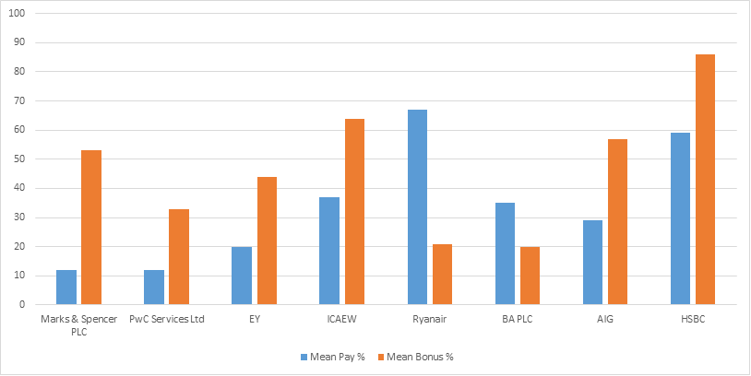
First Year Results - Individual Organisations
Company Examples
What do these percentages mean?
Notes:
JB

Slide 10
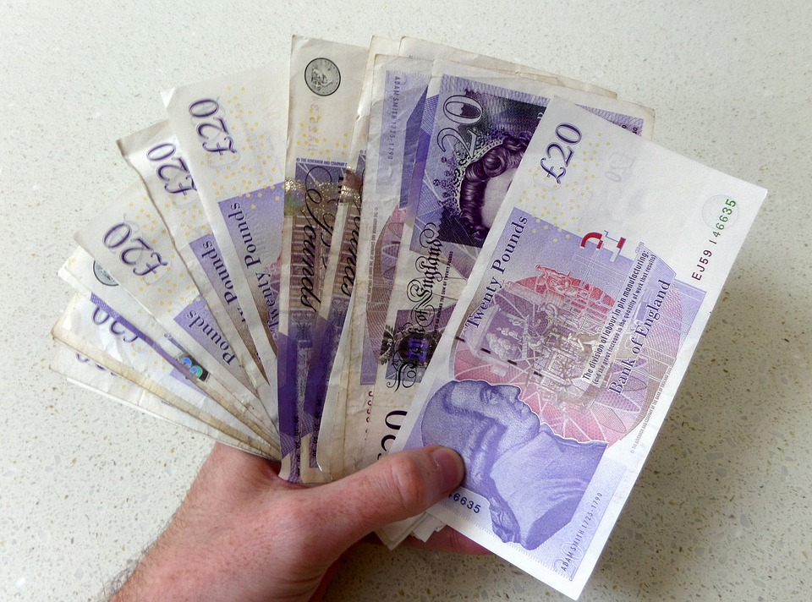
Why should we mend the gap?
Why does it matter?
  Equality of Opportunity
  Wasted Talent and Resources
Can it improve a company's performance?
  Research Findings
  Female spending power
  Market understanding
  Fresh thinking
  Effect on recruitment and retention
Diversity and Inclusion
  Not just gender
  Ethnicity
  Class
  Experience
  Fresh thinking
Notes:
J R-G to pose the question 'Why should we mend the gap'
KB to start discussion and JB to chip in - make sure cover all the headings
10 mins max

Slide 11

Can we mend it?
No quick fixes?
Barriers – a man thing or a female thing?
Female lack of confidence vs Male overconfidence?
'Leaning In'
Gender stereotyping
Flexibility
Notes:
J R-G to pose the question 'can we mend the gap'
KB to start discussion and JB to chip in - make sure cover all the headings
10 mins max

Slide 12

Is Flexibility the Key?
Who needs to be flexible?
Choosing my own hours?
Part time vs Full Time
Parental leave – not just maternity leave
Help for Career breakers?
Quotas?
Notes:
J R-G to pose the question 'Is Flexibility the Key'
KB to start discussion and JB to chip in - make sure cover all the headings
10 mins max

Slide 13
Future Developments?
Extended to more companies?
  Less than 250 employees?
  Voluntary Reporting?
  Overseas developments?
Penalties imposed?
  ECHR attitude
Reaction?
  Employees – vote with their feet?
  Employers – resist, ignore or react?
More reporting?
  Ethnicity pay gap reporting
Notes:
JB

Slide 14
Preparing for 2018 / 19
Reporting the gap is not the end only the beginning
Deadline for reporting 2018 figures = 4 April 2019 or 30 March 2019
By November 2018 only 440 had reported
How to prepare for 2019 and beyond?
Notes:
KB

Slide 15
Email
Share your experiences and tips with us
jane.berney@icaew.com
Notes:
JB

Slide 16
Further Information
ACAS - for advice on how to calculate and report
Government Gender pay gap service – who (and what) has been reported so far
Equalities and Human Rights Commission (ECHR) – advice and enforcement policy
ICAEW KNOW – How - guidance and Advice
ICAEW Diversity Community - information and best practice guidance on the different areas of diversity, to educate, support and raise awareness
PwC –Research and Commentary on diversity and inclusion
Notes:
J RG to read and then thank us and listeners

