Slide 1
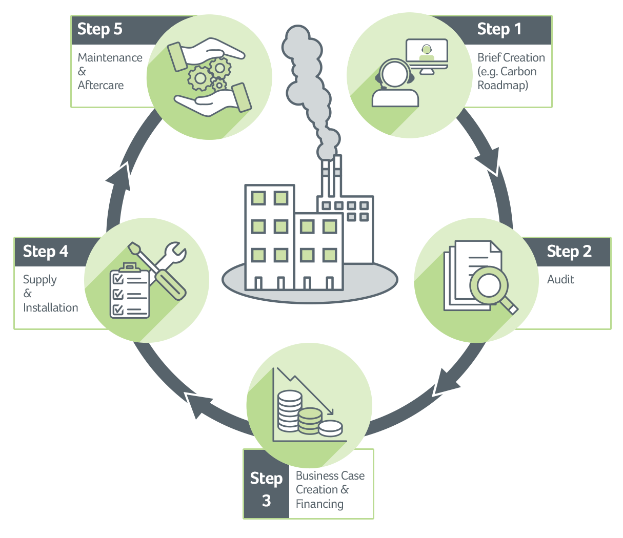
SaveMoneyCutCarbon
Member Rewards Partner with ICAEW
SaveMoneyCutCarbon is the go-to-partner for Sustainability.
We help businesses and consumers take practical steps to a more sustainable future by providing products, solutions and expertise to support the full range of ESG and financial goals.
Our promise is in our name; it reflects the clear, no-nonsense way we go about our work.
We offer a complete end-to-end Decarbonisation service and have completed over 1,000 energy, water and carbon reduction audits and projects.
Last year alone our customers collectively saved:
Millions of pounds off the bottom line and

Slide 2
SaveMoneyCutCarbon
Member Rewards Discounts for ICAEW Members:
ICAEW Members can benefit from our partnership in the workplace and at home by:
Reducing the carbon footprint & running costs of your buildings - We provide a complete end-to-end Decarbonisation service. ICAEW members can access a free call with one of our IEMA qualified Carbon Mentors to assess your decarbonisation aims. After this you can opt for an audit of your buildings to identify energy and water savings or a carbon roadmap before we recommend retrofit projects based on payback and ROI. Book at www.savemoneycutcarbon.com/icaew
Adding value to your B2B clients & supply chain - We can offer your clients or your supply chain a free call with a Carbon Mentor on your behalf at no cost to yourself. Find out more here: www.savemoneycutcarbon.com/icaew-find-out-more
Eco-friendly swaps for your home – Download our app (search SaveMoneyCutCarbon Home on the App Store or Google Play) and visit our Swap Shop for planet friendly products you can use in your home which will also help reduce your domestic energy and water bills. ICAEW Members receive a 10% discount when they join our Home Club giving them unbeatable pricing and free delivery. Enter code ICAEWHC-DIS50 at checkout and find out more here: www.savemoneycutcarbon.com/supporting-icaew-members

